Slide 1

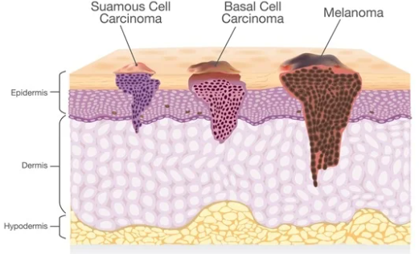
Skin Cancer Detection

Slide 2






Members
Suhail
Robert
Joshua
Kavya
Adesoji

Slide 3
The Problem

Slide 4
Problem statement
State the problem you are solving in one or two sentences.
We are trying to make skin cancer detection
-More Economical
-More Accurate
- Increase speed of diagnosis

Slide 5
What customers do today
Justify your effort to try to solve the problem.
Customers go to a dermatologist which is expensive without insurance as well as it can take a long time to get an appointment

Slide 6
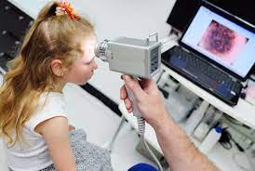
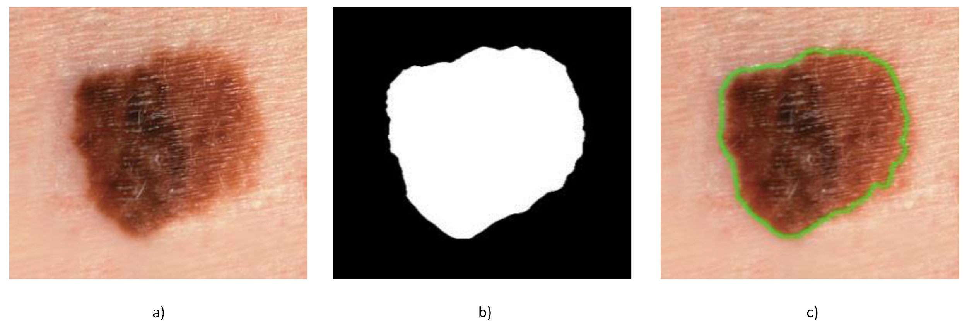
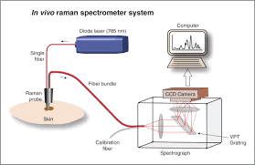
Supporting information
Dermoscopy Technique
Melanoma Skin Cancer Detection using Support Vector Machine.
Identifying multiple ways to detect skin cancer through image classification. With our research we found multiple ways to detect skin cancer. Two of those being dermoscopy and spectroscopy based techniques using Computer Assisted Diagnosis.
Spectroscopy Technique using Raman spectrometer system

Slide 7
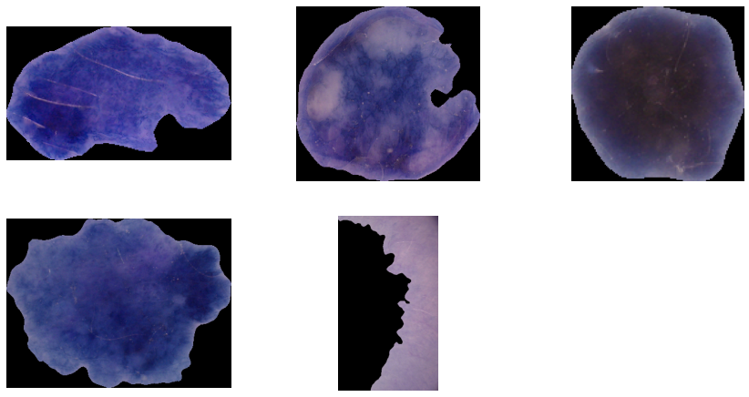
Reasoning
The reason we’re focusing on multiple techniques and methods are simply to understand and to see which method will best detect skin cancer. Multiple methods have been developed but our mission is to figure out which method is the most reliable for getting correct accuracy.

Slide 8
The 4 Stages to Skin Cancer Detection
Acquire the image set
Segmentation (which include several methods such as techniques based on edges, thresholding, histogram segmentation, region growing, etc.)
Feature Extraction
Classification or detection of a lesion for diagnosis

Slide 9
Assumptions
The assumptions are very simple more research will be done to provide better accuracy. More methods will come along as technology advances that will enable more diagnostics.

Slide 10
Dataset + Preprocessing

Slide 11
Dataset
HAM10000 Dataset (“Human Against Machine with 10000 training images”) - Large collection of dermatoscopic skin lesion images.
Contains 7 classes of skin cancer (both benign and malignant).
1. Dermatofibroma (df) 5. Melanoma (mel)
2. Vascular lesions (vasc) 6. Benign keratosis-like lesions (bkl)
3. Melanocytic nevi(nv) 7. Basal cell carcinoma (bcc)
4. Actinic Keratosis / Bowen’s disease (akiec)

Slide 12
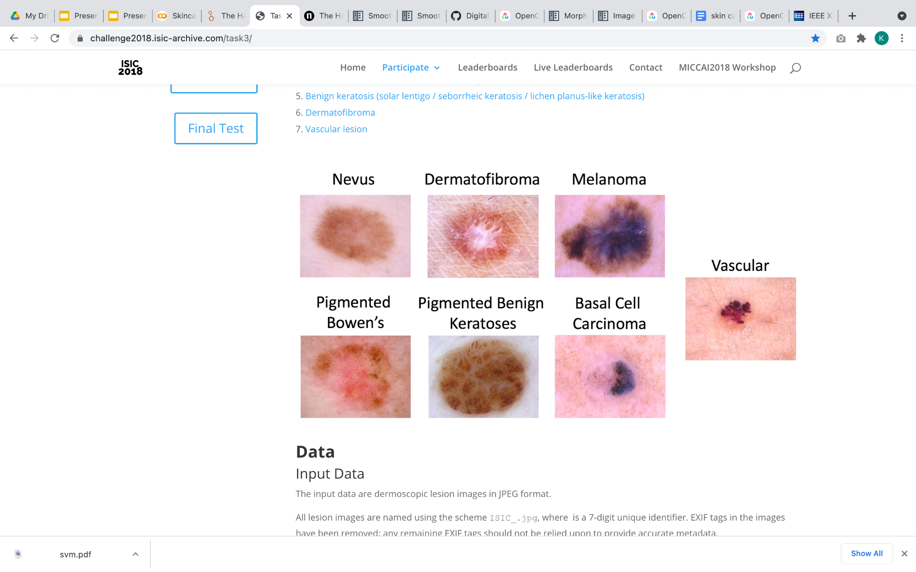
Skin Lesion Images

Slide 13
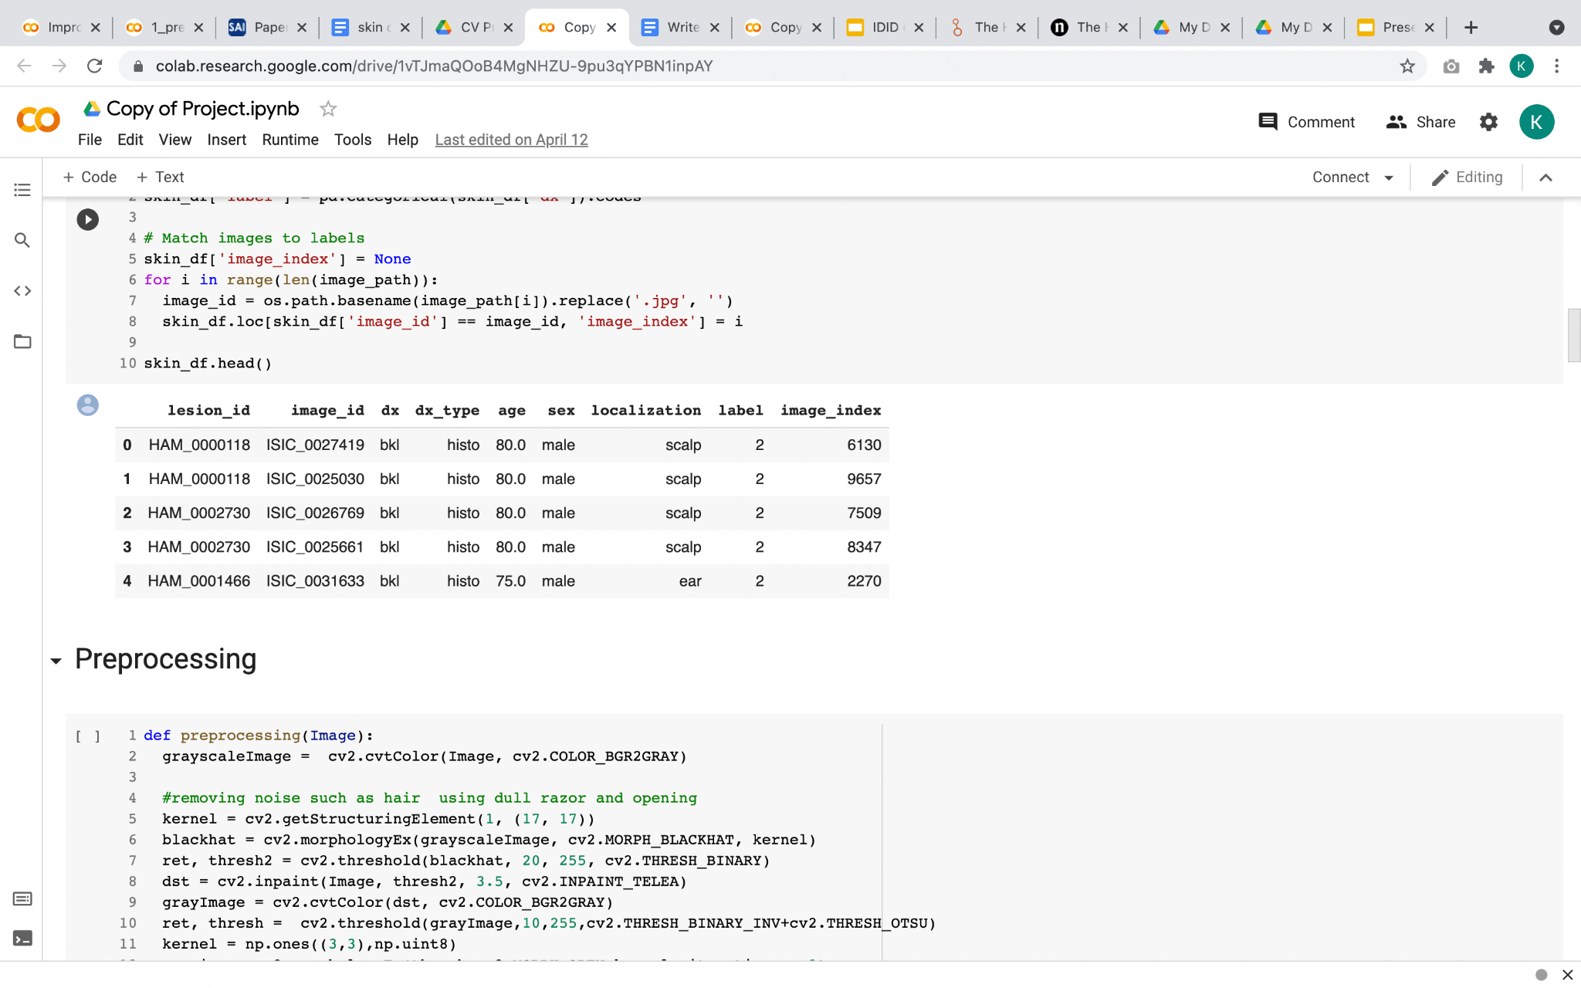
What does the dataset look like?

Slide 14
Preprocessing & Image Segmentation
Skin images might contain different unwanted artifacts such as fine hair, air bubble and noise.
Enakshi, et al. introduced preprocessing pipeline for removing hair and noise from the dermoscopy images - Research on Skin Cancer Cell Detection using Image Processing.
The second stage after preprocessing is detecting and segmenting the region of interest (ROI) which represents the lesion region.
Ali Mohammad, et al. provided efficient method for extracting the region of interest - The Melanoma Skin Cancer Detection and Classification using Support Vector Machine.

Slide 15
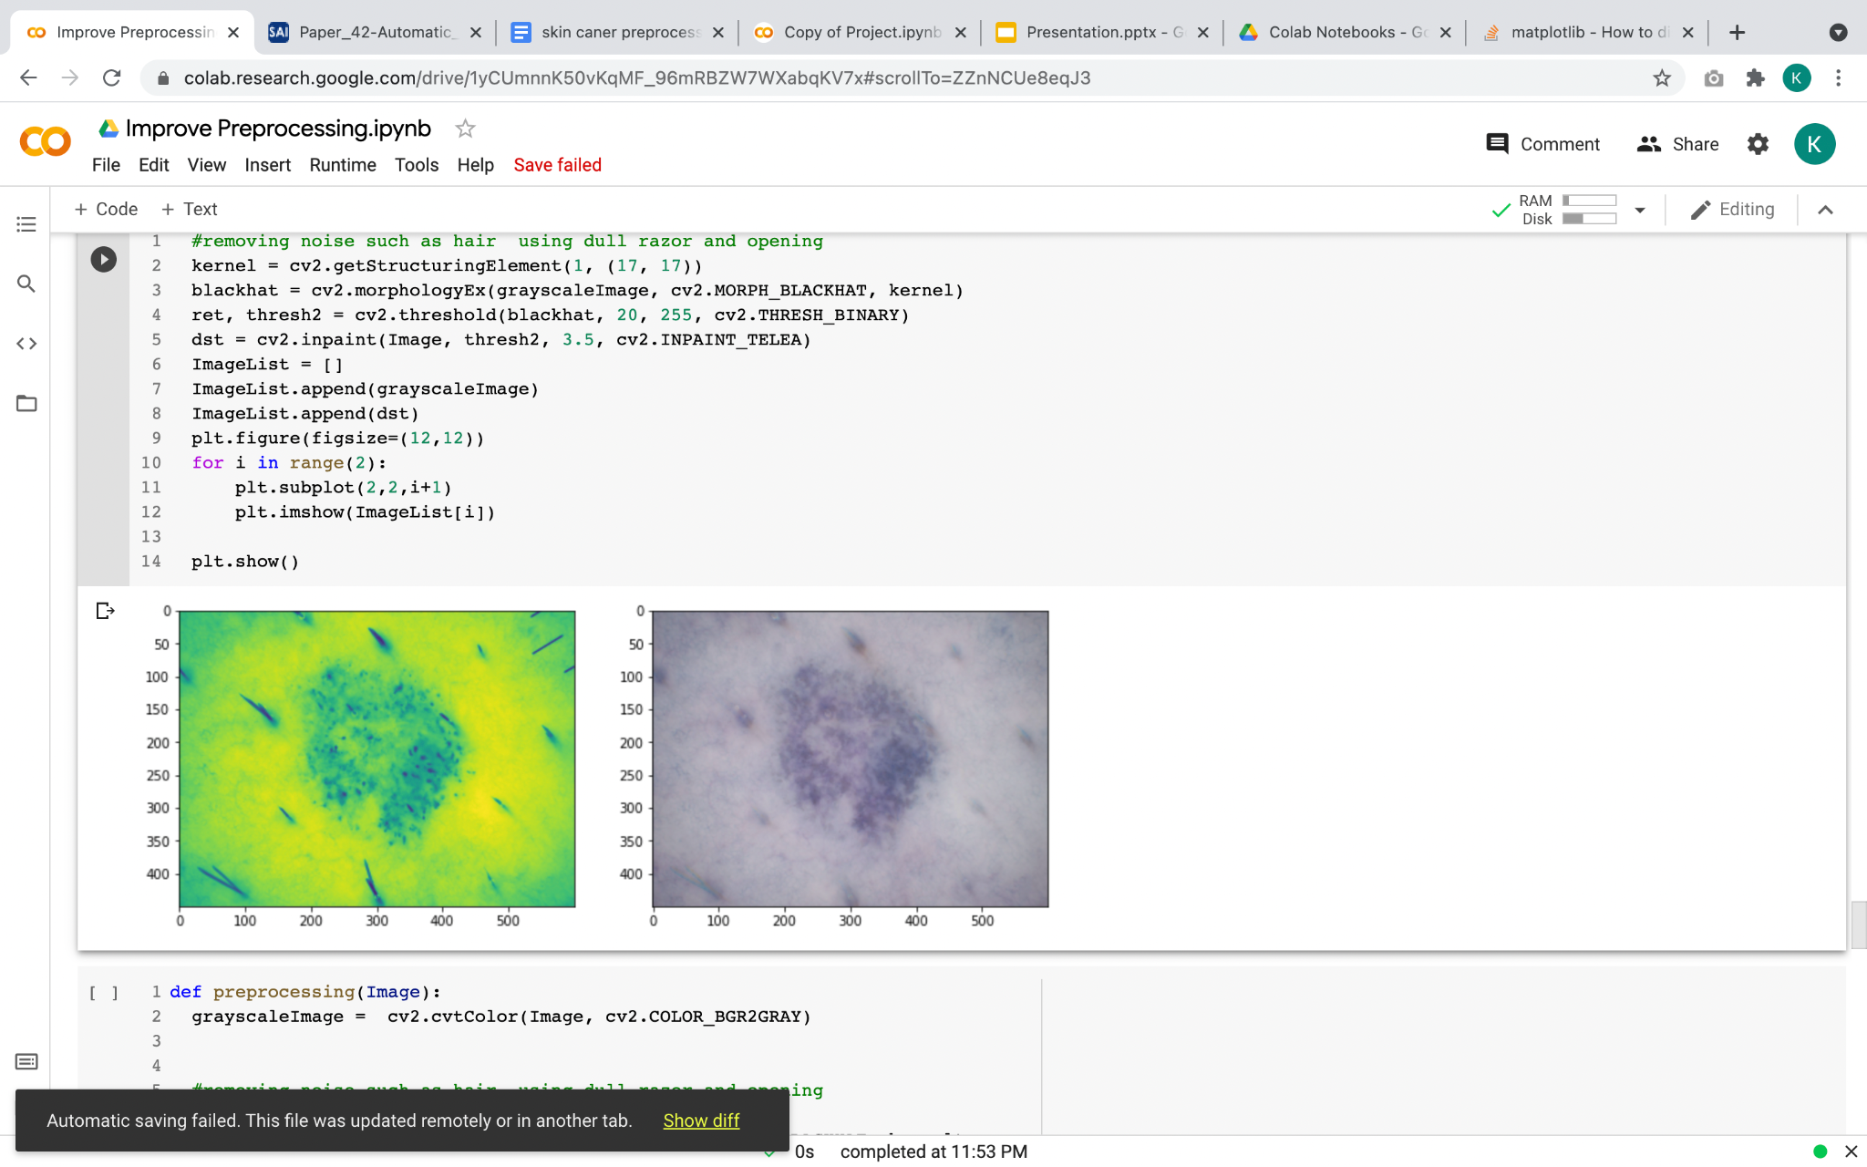
Preprocessing
Step 1 : Remove unwanted artifacts like hair by Dull Razor Method.
Step 2 : Remove noise by Image Blurring

Slide 16
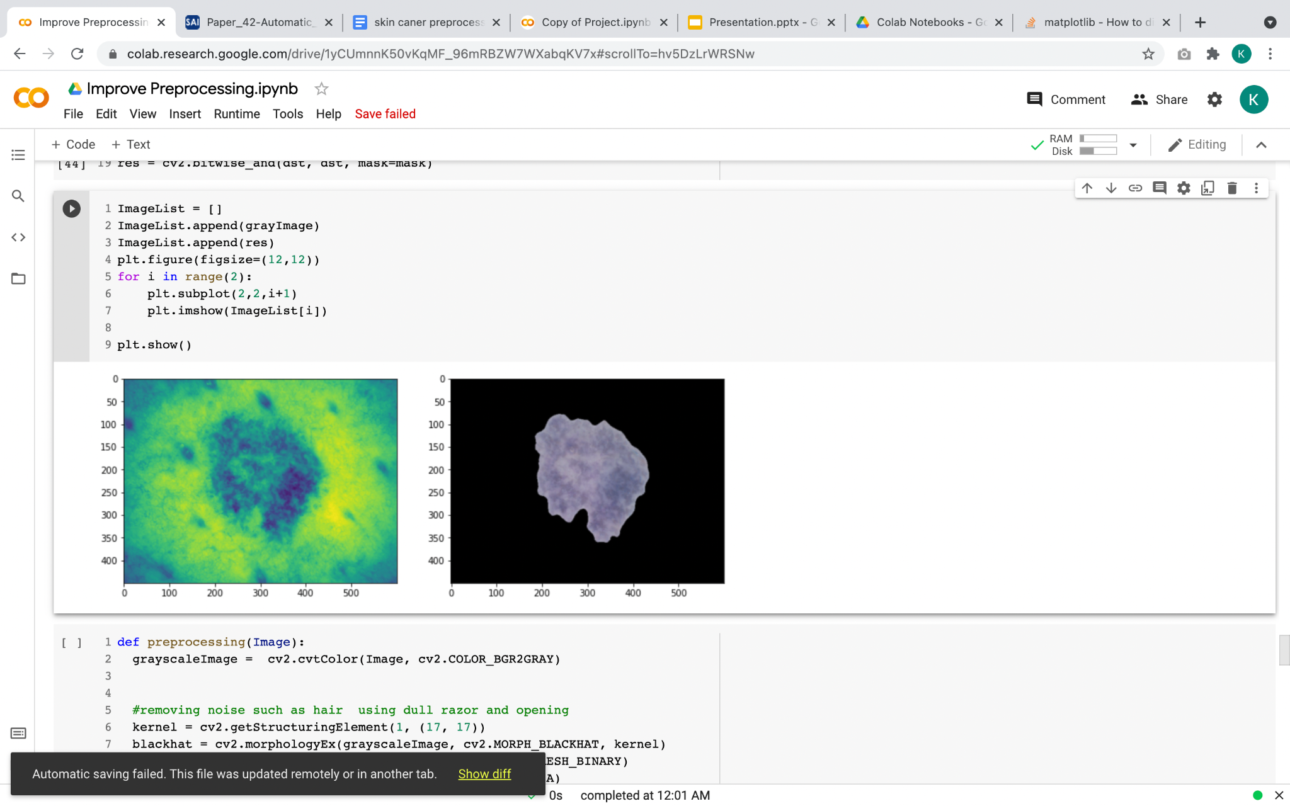
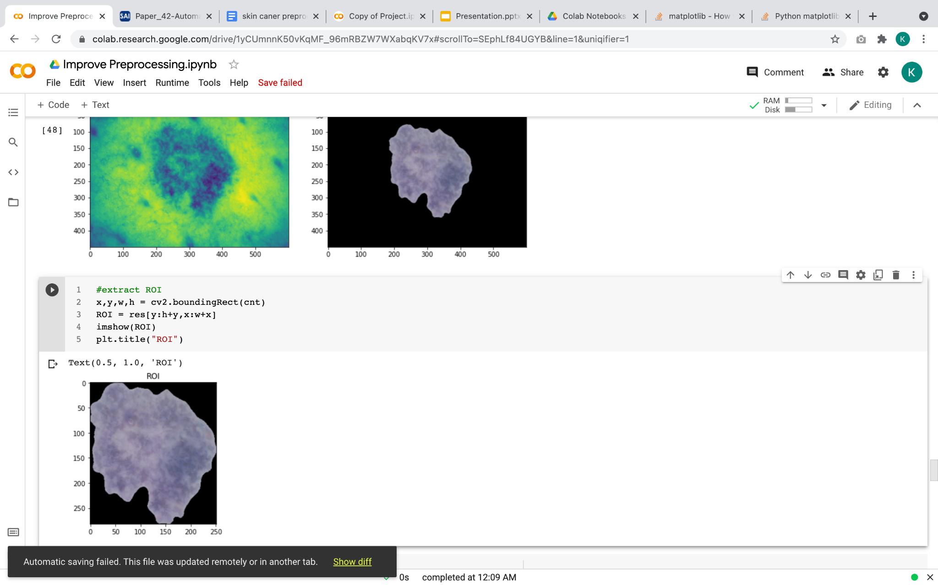
Image Segmentation
Preprocessing
Step 3 : Segmentation of lesions by finding contours.
Step 4 : Extracting the region of interest(ROI).

Slide 17
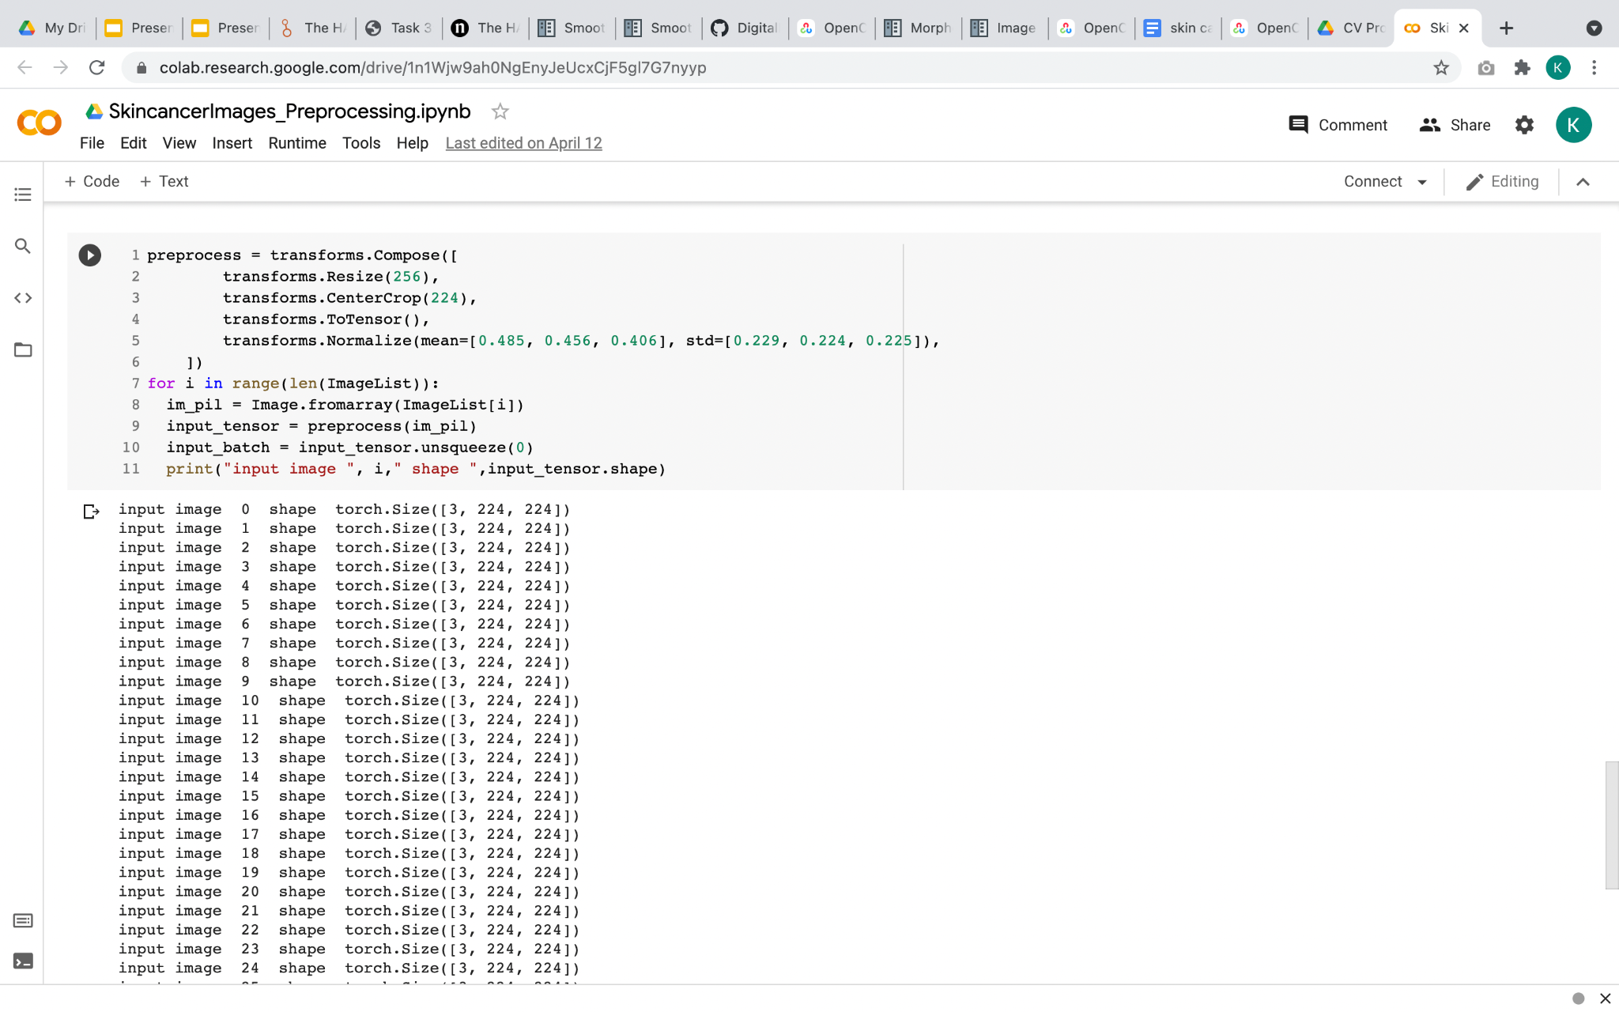
Normalize the data
Preprocessing
Step 5 : Normalizing the data.
Mean = [0.485, 0.456, 0.406]
Standard deviation = [0.229, 0.224, 0.225 ]
Image Shape (3 X H X W) ,
where H and W be at least 224.

Slide 18
Solution Proposal

Slide 19
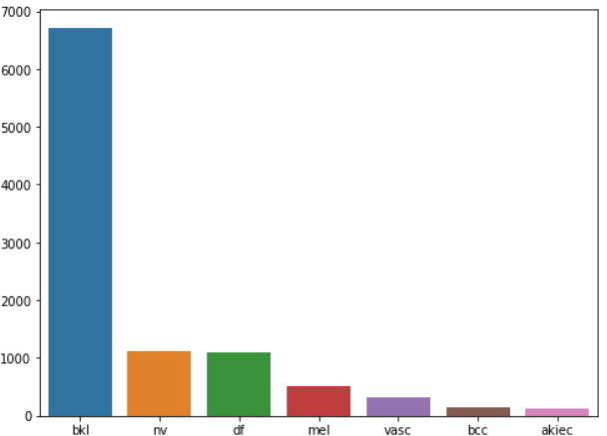
Class Distribution
1
Weighted Sampler: Weights inversely proportional to sample size

Slide 20
Training Characteristics
Weighted Data Loader
Batch Size: 64
Train-Test split: 0.8
Epochs: 25
ResNet-50 with ImageNet weights

Slide 21
Transfer Learning > Building Own Model
Better Accuracy
Faster Convergence
Easier

Slide 22
ImageNet for Medical Domain?
Earlier layers: extract image features
‘If our dataset represents some very specific domain, say for example, medical images or Chinese handwritten characters, and that no pre-trained networks on such domain can be found, we should then consider training the network from scratch.’ –StackExchange
‘In skin lesion classification, pretraining is performed using ImageNet. Despite the nonmedical image domain, the learned features have sufficient quality for lesion classification’ –Menegola et al., 2017

Slide 23
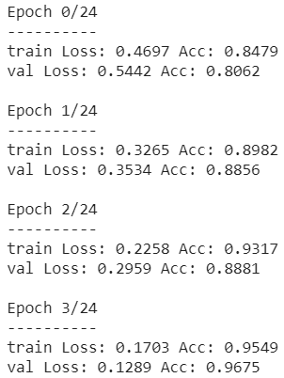
Training Results
Accuracy > 0.96 with 4 Epochs
Loss: Cross Entropy
Optimizer: SGD

Slide 24
Results

Slide 25
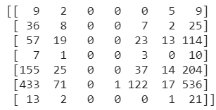
Performance before Fine-Tuning
Confusion Matrix
Low Accuracy: 0.046
Low Precision & Recall

Slide 26
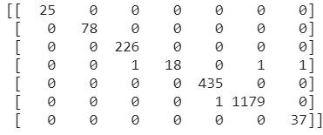
Performance after Fine-Tuning
Confusion Matrix
High Accuracy: 0.998
High Precision & Recall

Slide 27
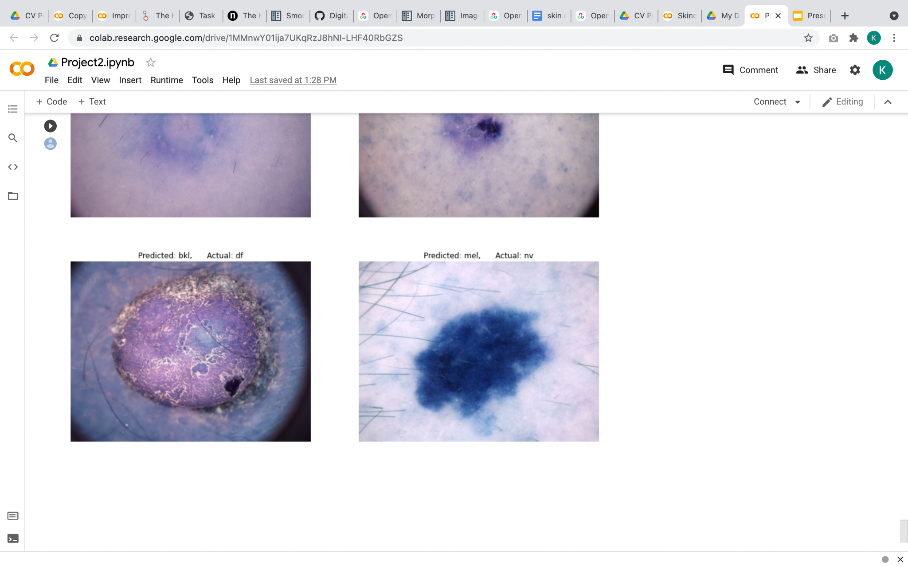
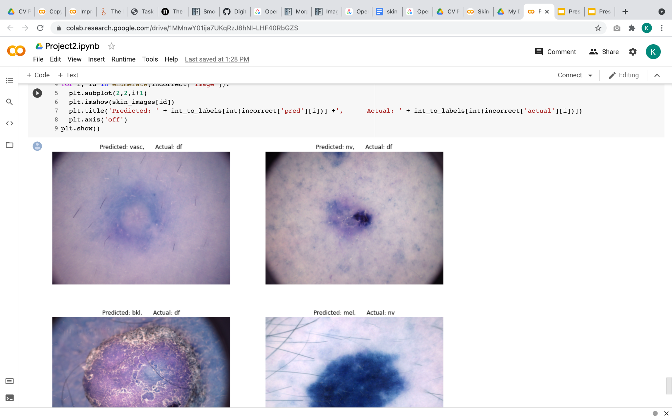
Misclassified Images
Mislabelled Predictions Predicted Actual

Slide 28
Misclassified Images
Mislabelled Predictions Predicted Actual

Slide 29
Next Steps

Slide 30
What next?
Develop a mobile application for real time classification of skin lesions.
Enhance the input images for performing segmentation along with classification.

Slide 31
Questions?

